Slide 1
Chapter 18 - Human Decision Making and recommender systems
Luis filipe kopp
Samyr
ramon

Slide 2


CHoices
Recommender Systems: tools for helping people to make better choices [that the chooser will ultimately be satisfied with – following the recommendation or not.]
How people make choices? And the machines?

Slide 3
Johnson & Goldstein (2001)

Slide 4


Slide 5
Check this box if you want to
participate in the organ donors program
Check this box if you do not want to participate in the organ donors program

Slide 6

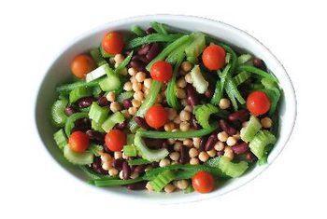
“What if recommendations are biased?”
Notes:
Green tea – ask sugar for green tea in Japan and manager come and say they don’t have sugar. Ask coffee and they bring sugar.
Free choice x the duty to teach better choice
Healthy food – ifood – pizza or salad?

Slide 7

Perception

Slide 8
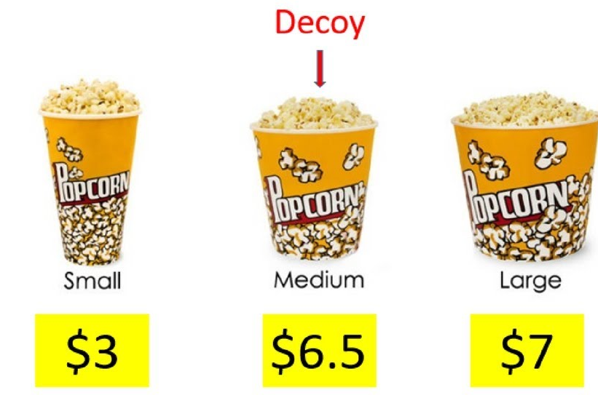
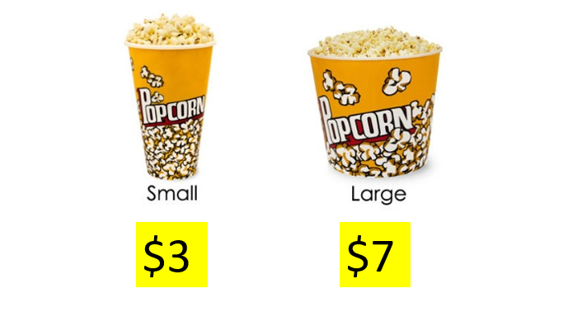
Decoy effect
https://youtu.be/33aaQdtD20k

Slide 9



Slide 10
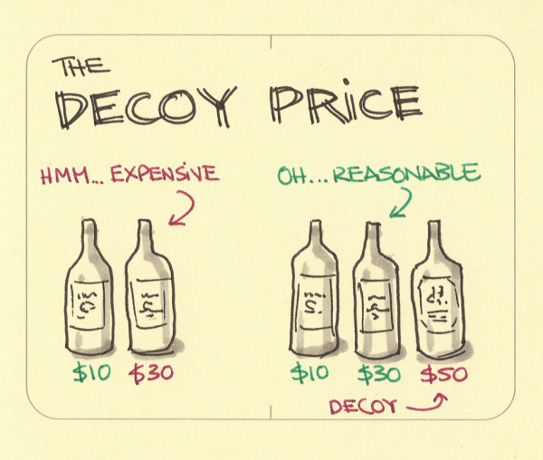

Slide 11
CHoices
Recommender Systems: tools for helping people to make better choices [that the chooser will ultimately be satisfied with – following the recommendation or not.]
How people make choices? And the machines?

Slide 12
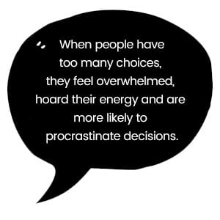

Slide 13
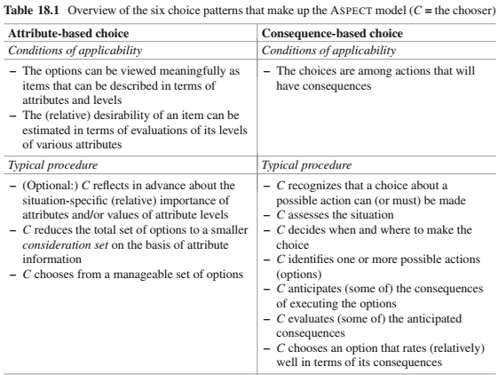
The recommender can help the chooser arrive at evaluations of particular consequences. Even if a chooser knows that a particular consequence will occur, she may have a hard time anticipating accurately how good or bad this consequence will be for her.
a recommender system can help reducing a very large set of options to a smaller consideration set.

Slide 14
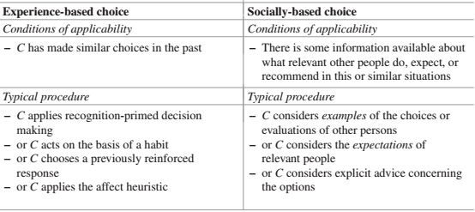
Some trust-based recommender systems take into account the social relationships between the chooser and the other persons whose opinions and choices are being considered
People often allow their choices to be influenced by the examples, or advice of others. If many other people have tried a service/product and rated it positively, their ratings can be seen as a summary of a great deal of relevant experience that it would be impractical for the current chooser to acquire himself.
Recommender systems can be seen as taking over the process of experience-based choice by analyzing the chooser’s relevant previous experiences, while keeping the chooser more in the loop is by helping the chooser to remember and take into account relevant aspects of her previous experience.

Slide 15
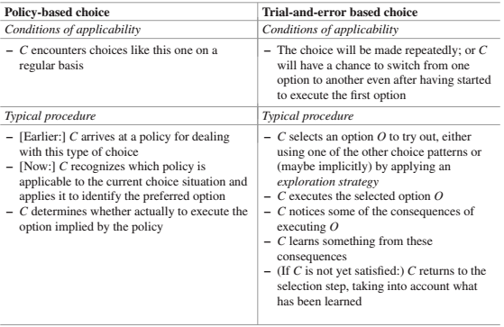

Slide 16
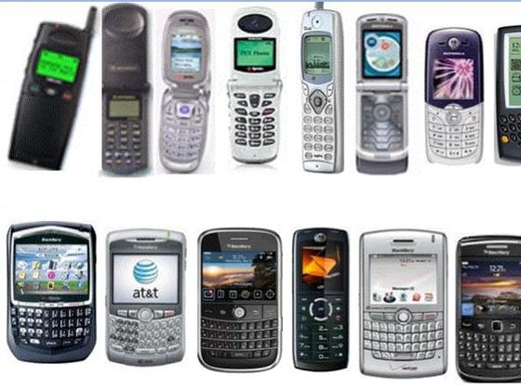
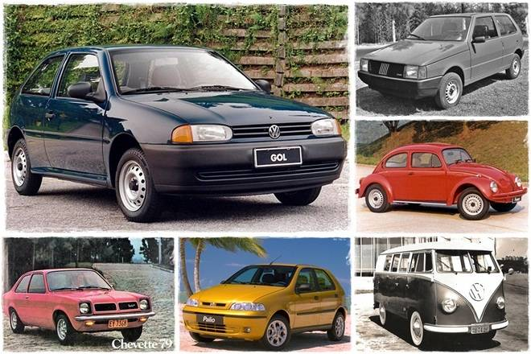

Slide 17



Slide 18
Conlcusions
The understanding of this topic is of high importance for companies
Research has clearly pointed out that preference stability in decision processes does not exist
For instance, a customer who purchases a digital camera could first define a strict upper limit for the price of the camera, but because of additional technical information about the camera, the customer could change his or her mind and significantly increase the upper limit of the price.

Slide 19
Conclusions – Preference construction
Theory | Description
Context effects | Additional irrelevant (inferior) items in an item set significantly influence the selection behavior
Primacy/recency effects | Items at the beginning and the end of a list are analyzed significantly more often than items in the middle of a list
Framing effects | The way in which different decision alternatives are presented influences the final decision taken
Priming | If specific decision properties are made more available in memory, this influences a consumer's item evaluations
Defaults | Preset options bias the decision process

